Slide 1

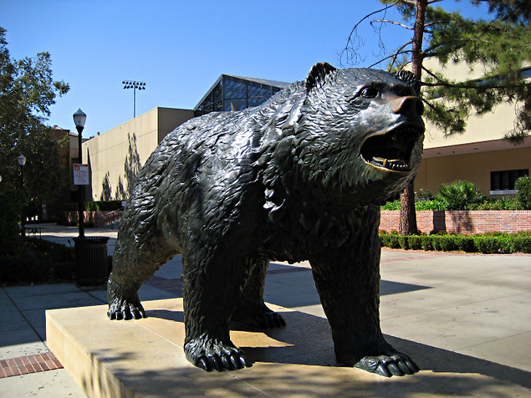

Slide 2
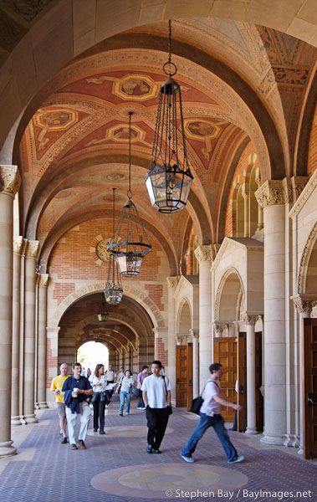
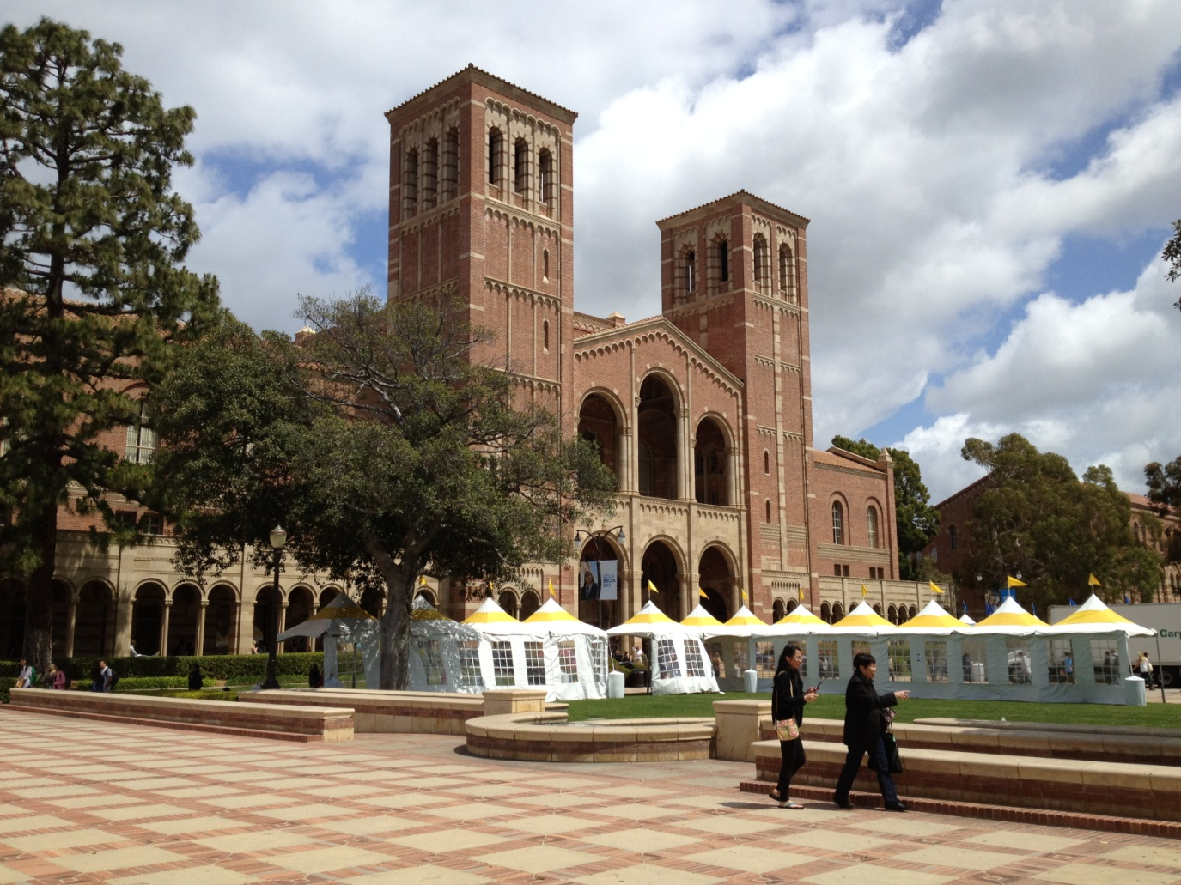
Royce Hall
- An iconic building of UCLA - One of the original four buildings

Slide 3
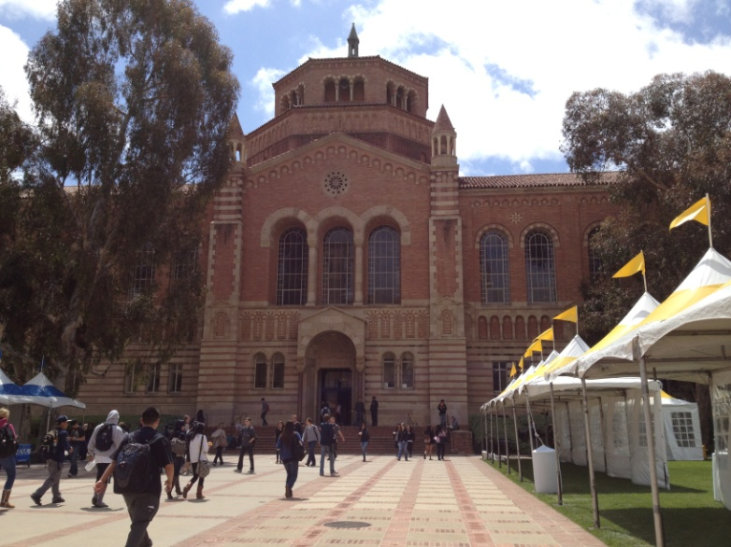
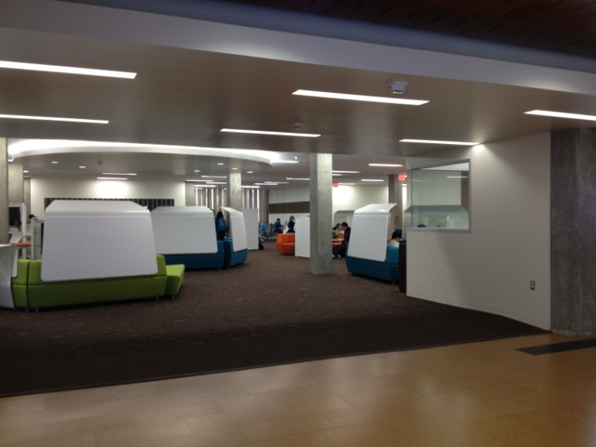
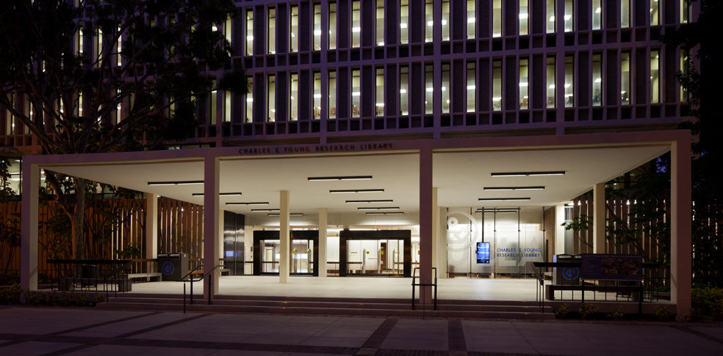
Libraries (2 out of 10)
Powell Library
Charles E. Young Library

Slide 4
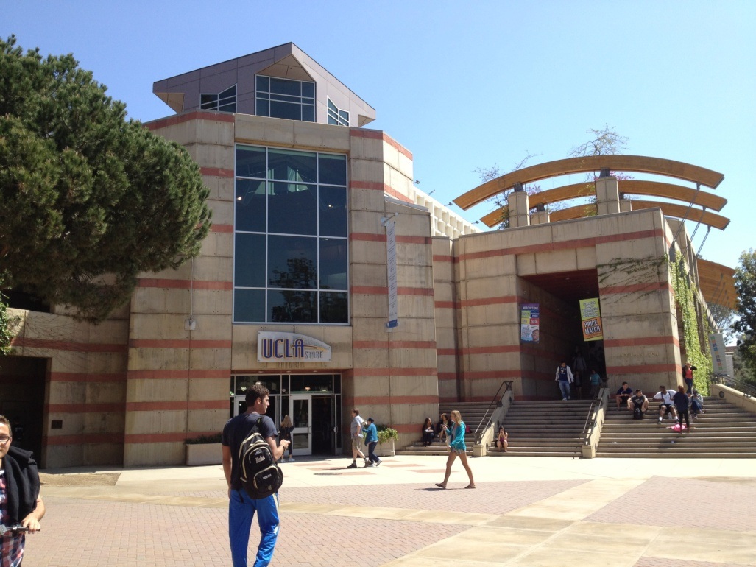
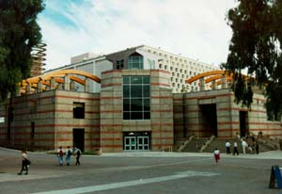
Ackerman Union
- UCLA student store
- UCLA bookstore
- Food court
- Post Office
- TV lounge

Slide 5
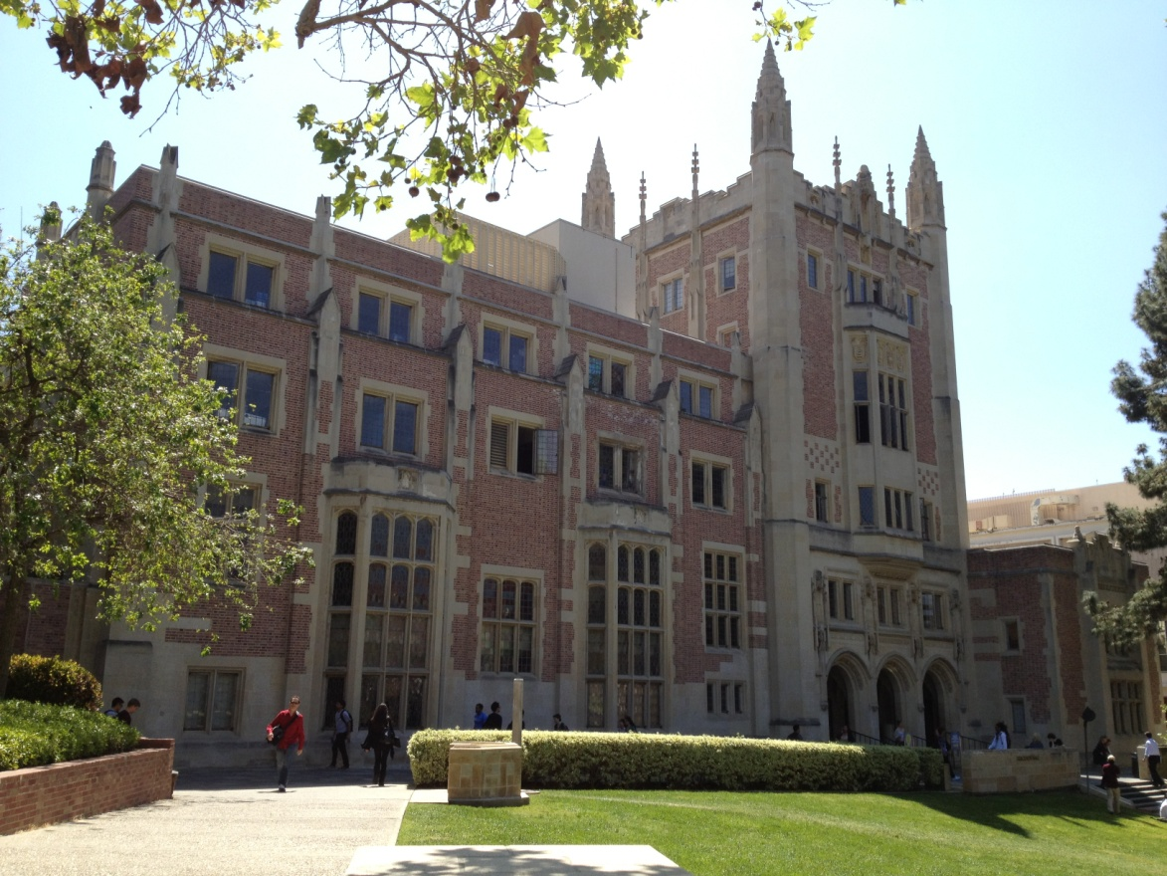
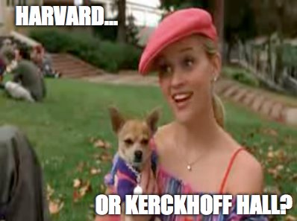
Kerckhoff Hall
Aka “Harvard” in Legally Blonde
One of the main Student Union Buildings
- Houses the ASUCLA and Yearbook offices

Slide 6
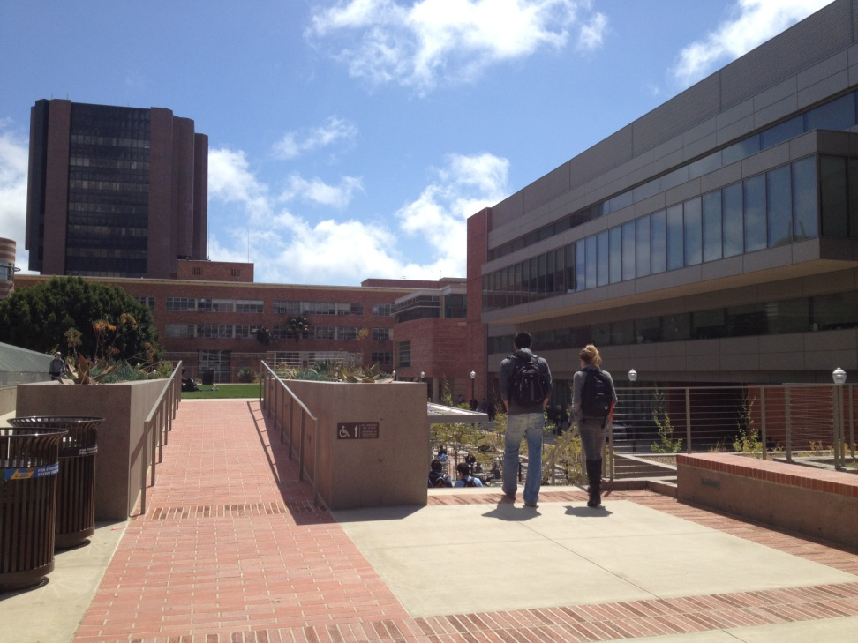
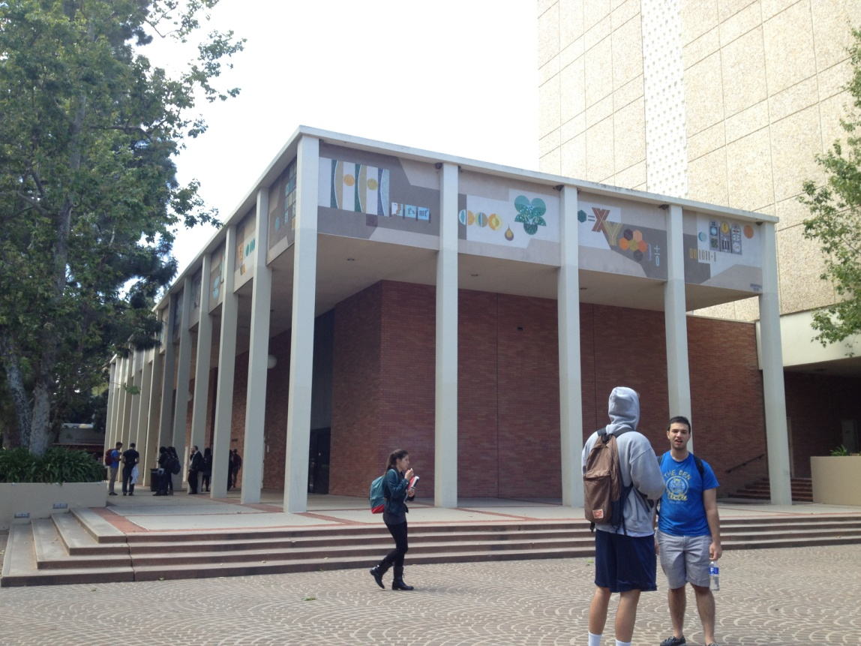
South Campus
Kinsey Pavilion
South Campus Court of Sciences

Slide 7
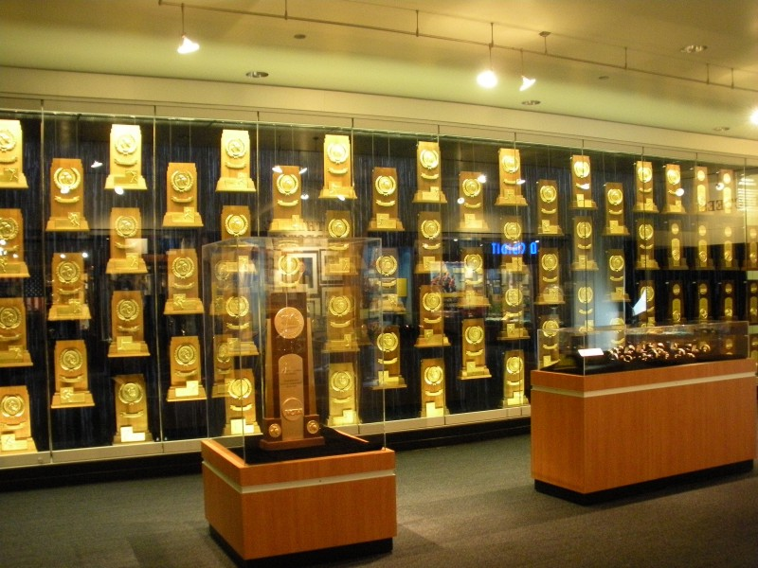
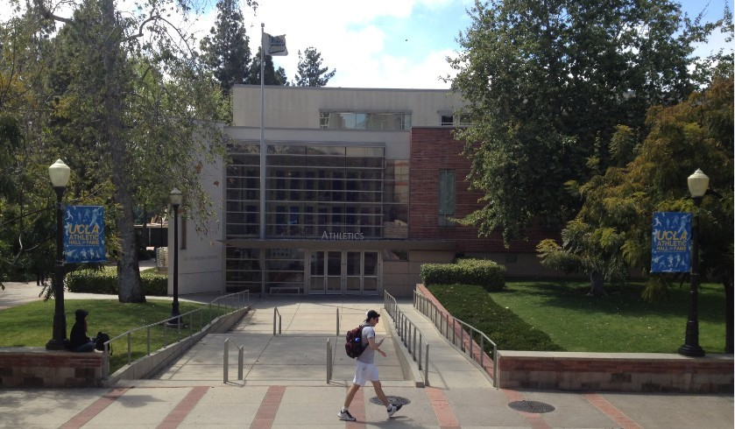
Morgan Center-Athletic Hall of Fame
108 NCAA Team Championships
(Most in NCAA History)

Slide 8
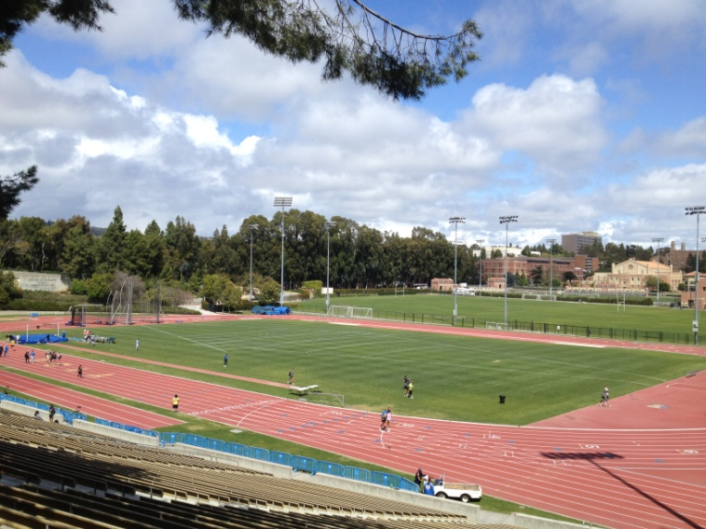
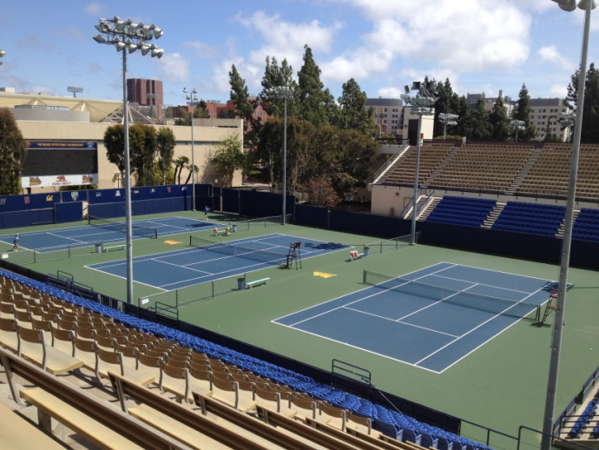
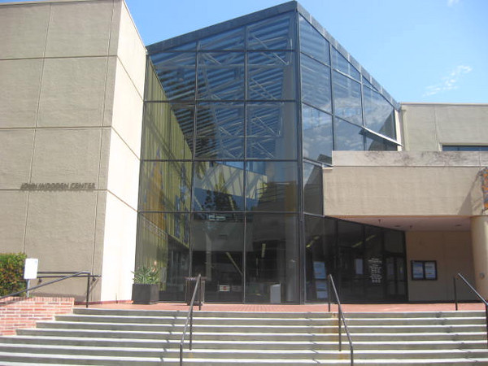
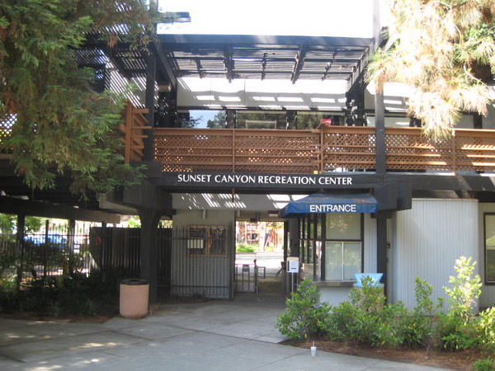
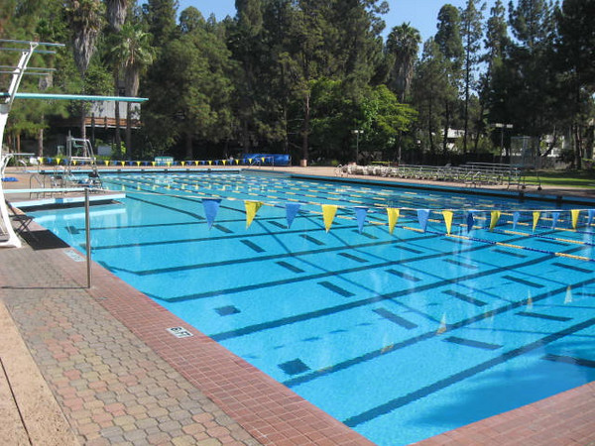
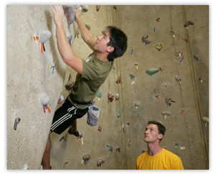
Recreation
Drake Stadium
Straus Stadium
John Wooden Center
Sunset Canyon Recreational Center

Slide 9
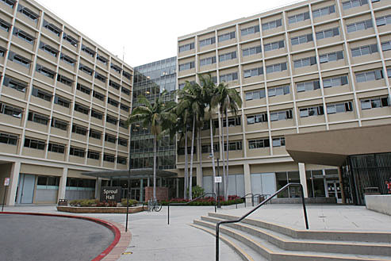
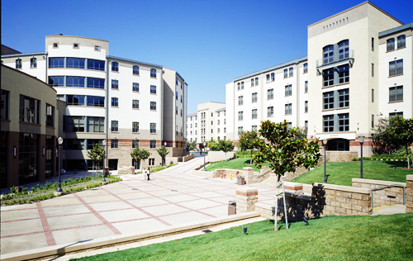
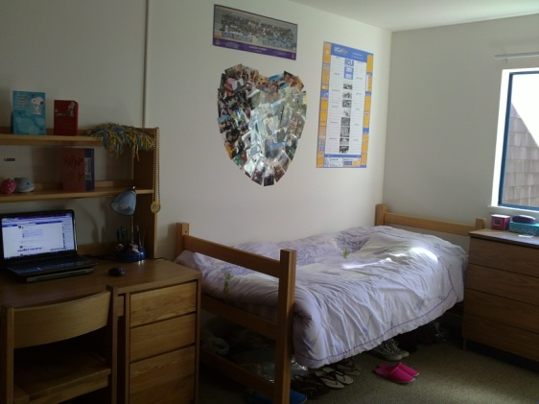
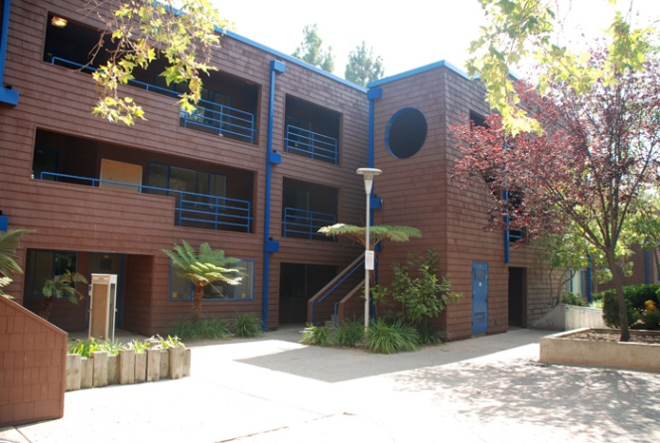
The Hill- Dorms
3 Types:
Halls
Plazas
- Suites
Online Housing Tour: http://www.uclahousingtour.com/

Slide 10
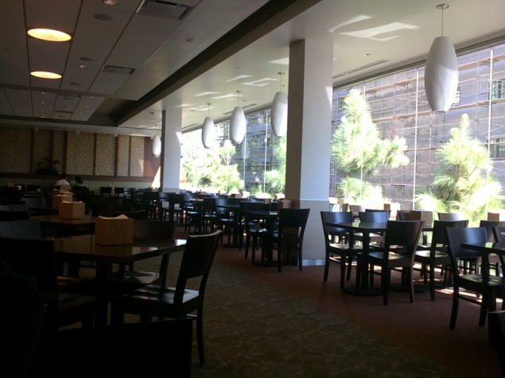
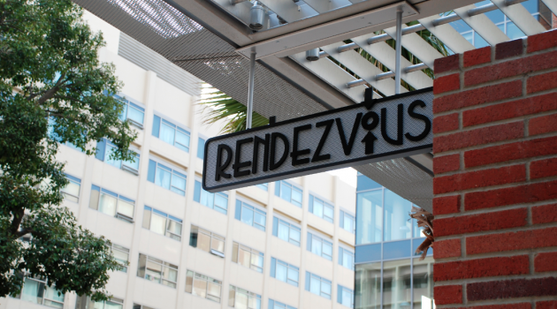
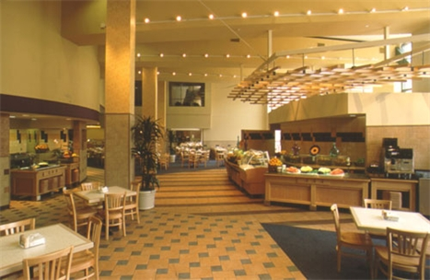
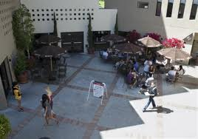
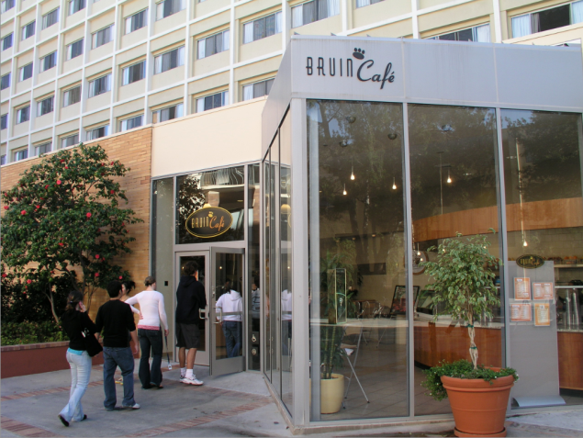
The Hill- Dining
Dining Halls
Café 1919
B-Cafe

Slide 11
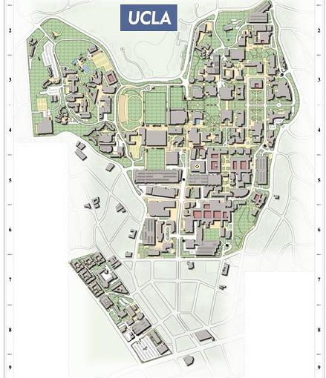
Hope you love UCLA as much as I do!
~Welcome Future Bruins~

